Slide 1
PLACEMENT MANAGEMENT SYSTEM
By VishakhaPatil

Slide 2
INTRODUCTION
Whether entering the job market for the first time or re-entering after a break or switching career, job search is a challenging task. But how about tools/applications, making this tedious process look friendly, systematic and easy to reach out, to employers or candidates. Searching and landing up with a dream job is a tedious process for a job seeker and on the opposite hand, connecting with desirable candidates best fit for a job position is a challenging and important work for the employers. This project is aimed at making such challenges much easier despite the geographic location of either the job seeker or the Company. Although a job search portal doesn’t guarantee a job offer, it is the best place for potential candidates and employers to get connected and know more about each other. A job search portal web application comes to rescue at this point where a lot of meaningful time can be saved as well as the cost of advertisements. The entire process of a job search or a candidate search is speeded up. Manual processes get replaced by automated processes. With job search portals the trend of paper resumes gets replaced by online resumes. These resumes are stored in company databases for future references also. Candidates and employers are just a few clicks away to get connected. Another advantage is once the candidate is registered and applies for a position, his/her information stays with the company database for both the present and future use for available positions. The traditional format of recruitments has been overshadowed with the modern simplistic approaches of e-recruitments.

Slide 3
System Analysis
During analysis, data collected on the various files, decision points and transactions is handled
by the present system. The commonly used tools in the system are Data Flow Diagram,
interviews, etc. Training, experience and common sense are required for collection of relevant
information needed to develop the system. The success of the system depends largely on how
clearly the problem is defined, thoroughly investigated and properly carried out through the
choice of solution. A good analysis model should provide not only the mechanisms of problem
understanding but also the frame work of the solution. Thus it should be studied thoroughly by
collecting data about the system. Then the proposed system should be analyzed thoroughly in
accordance with the needs. System analysis can be categorized into five parts.
➢ System planning and initial investigation
➢ Information Gathering
➢ Applying analysis tools for structured analysis
➢ Feasibility study
. Cost/ Benefit analysis

Slide 4
Project Description
This project deals with the requirements of a online job portal which is supposed to provide a
online facilities to find jobs. The job portal is required to find different types of jobs in our
website in free of cost .The “Placement management system” is a web application written in Windows operating
systems which is focused in finding jobs . This project is a menu driven project and to make it
user friendly it is implemented in the form of GUI (Graphical User Interface).There are basically
four modules in this project:
LOGIN PAGE
ADMIN LOGIN PAGE
JOBS FILTER PAGE
JOBS POST PAGE

Slide 5
Feasibility Study
Technical feasibility
The assessment of technical feasibility is based on an outline design of system requirements in
terms of Input, Processes, Output, Fields, Programs, and Procedures. This can be quantified in
terms of volumes of data, trends, frequency of updating, etc. in order to estimate whether the new
system will perform adequately or not. Technological feasibility is carried out to determine
whether the company has the capability, in terms of software, hardware, personnel and expertise,
to handle the completion of the project.
This “JOB PORTAL” serves the requirement of the organization and is very much technically
feasible. It has the technical guarantee and reliability as it has been tested by different

Slide 6
Requirement Analysis
Fact finding methodThe system should be able to interface with existing systemThe system should be accurateThe system should be better than the existing system. -System requirementThe software requirements specification is produced at the culmination of the analysis task. The function and performance allocated to software as part of system engineering are refined by establishing a complete information description, a detailed functional and behavior description and indication of performance requirement and design constraints, appropriate validation criteria and other data pertinent to requirement.

Slide 7
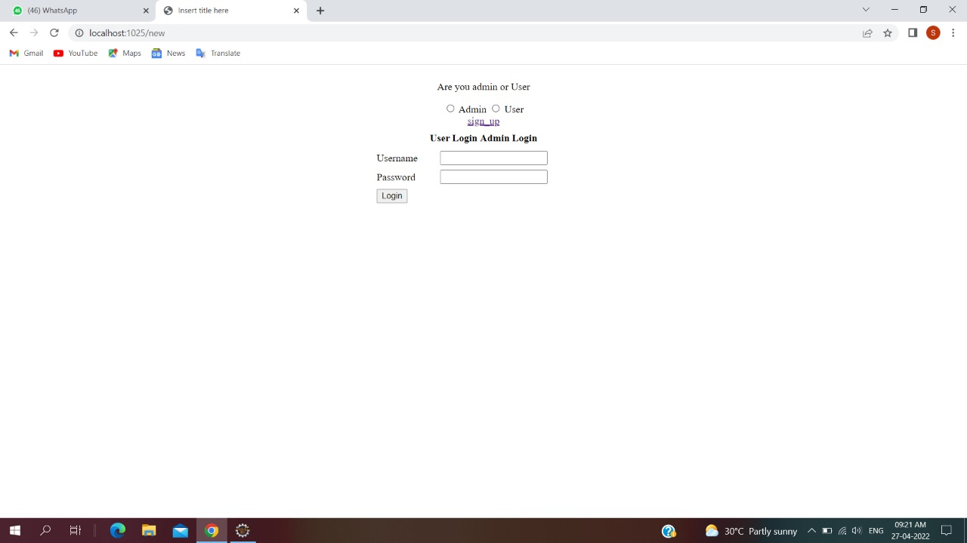
OUTPUT

Slide 8
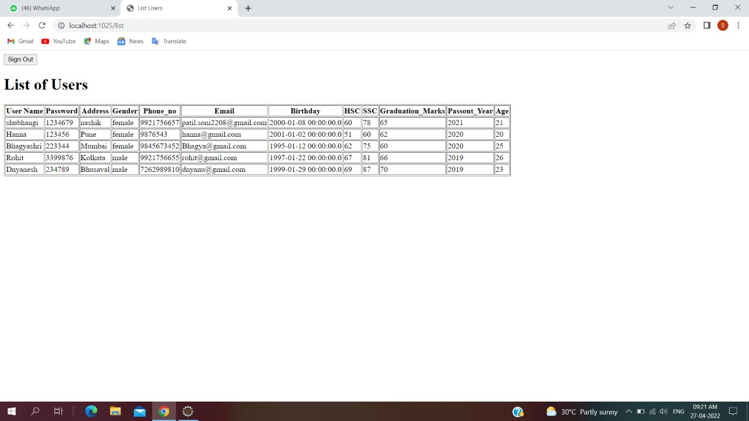
OUTPUT

Slide 9
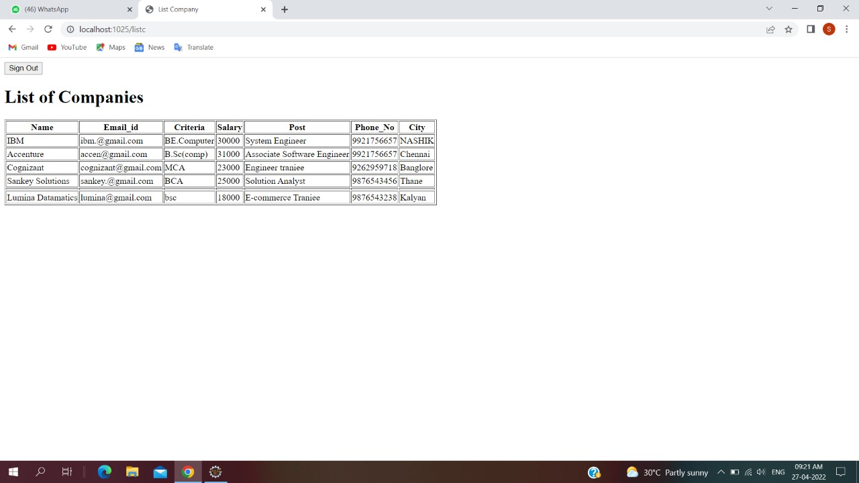
LIST OF COMPANIES

Slide 10
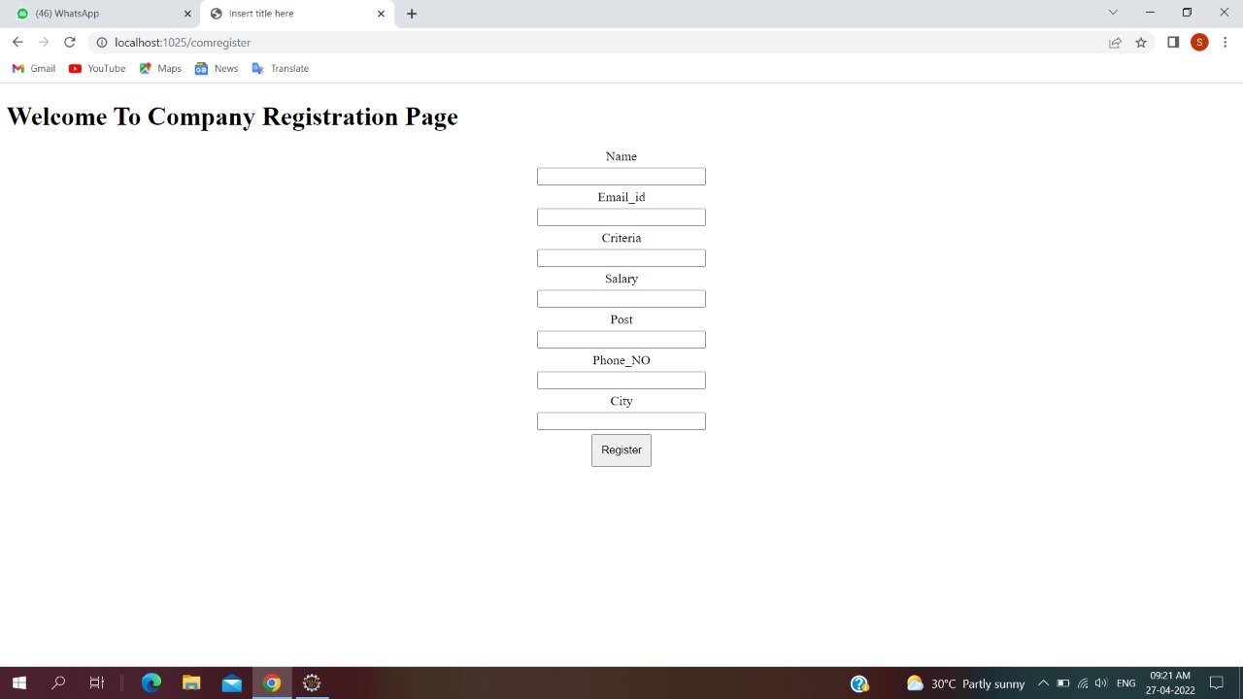
COMPANY REGISTRATION PAGE

Slide 11
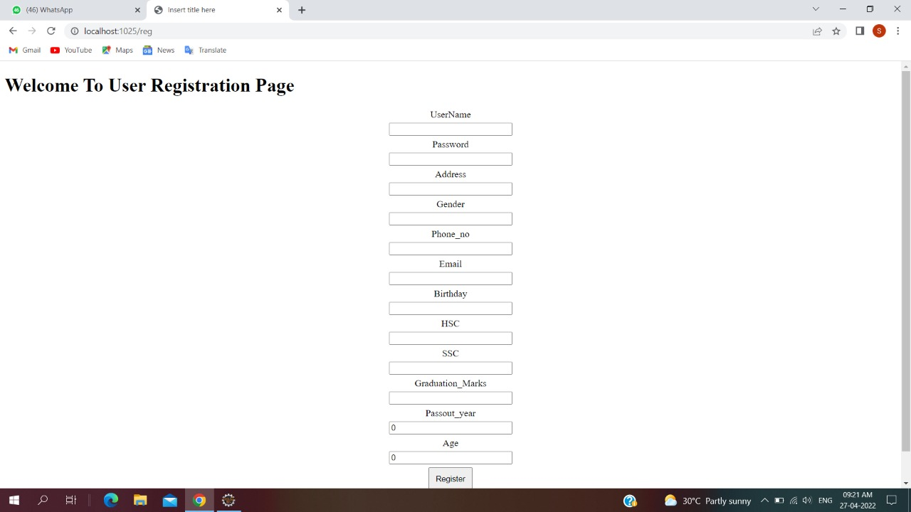
USER REGISTRATION PAGE

Slide 12
User Interface Design
The project JOB PORTAL is a GUI application. It is implemented using Swings in Java.GUI is
also known as WIMP interface as it makes use if Window, Icons, Menus and Pointers. Some of
the advantages of GUI are:
➢ Greater Accessibility – you have more capability at your cursor tip.
➢ Lower Cognitive Lode – By having everything laid out in front of you, you don’t have
to remember a lot of mundane things (like the proper formatting and the list of text
commands needed to copy a document). The GUI takes care of most of that freeing up
your mental processing power for the important stuff.
➢ Higher Productivity – when you get down to it the GUI is all about productiv

Slide 13
IMPLEMENTATION
Implementation is the stage in the project where the theoretical design is turned into a working
system. The implementation phase constructs, installs and operates the new system. The most
crucial stage in achieving a new successful system is that it will work efficiently and effectively.
There are several activities involved while implementing a new project. They are

Slide 14
System Testing
The testing activities are done in all phases of the life cycle in an iterative software development
approach. However, the emphasis on testing activities varies in different phases. The testing
process focuses on the logical intervals of the software ensuring that all statements have been
tested and on functional interval is conducting tests to uncover errors and ensure that defined
input will produce actual results that agree with the required results. Program level testing,
modules level testing integrated and carried out.

Slide 15
Future Enhancement
The propose of this job portal is to automate the existing manual system by the help of computerized equipment and full-fledged computer software requirement, full filling their requirement. So that their valuable data/information can be stored for longer period with easy accessing and manipulation of same. The required software and hardware are easily available and easy to work with.

Slide 16
Conclusion
The wider areas of job searching facilitate the quick and easy access to opportunities. The increasing job opportunities and changing scenario of the business environment today has made more people to search for better career and employers to search for better potential. This situation has prompted many to move to job portals to look for the ways that has been widely accepted and fully useful in job searching. In this sense the job portals assumes greater importance and we could develop such an efficient system which is used by lot many job hunters and employers.

